Slide 1
Camera Database Application
Hanwei Tang
Software Dev Engineer Intern
hanwtank@amazon.com
Jul 26, 2022

Slide 2
Introduction
This project aims to serve for the experimental data management of Camera team.
We want to use database system to manage engineers' experimental files and data. At the same time, file can be searched more efficiently in the database, for example, images can be quickly screened out according to the parameters of image.
本项目旨在服务于Camera团队的实验数据管理。我们希望利用数据库系统来管理工程师的实验文件和数据。并且可以在数据库中更高效地实现文件搜索，例如可以根据图像的参数快速筛选出图像。

Slide 3
Application
1. Log-in Page
2. Dashboard Page
3. Upload Page

Slide 4
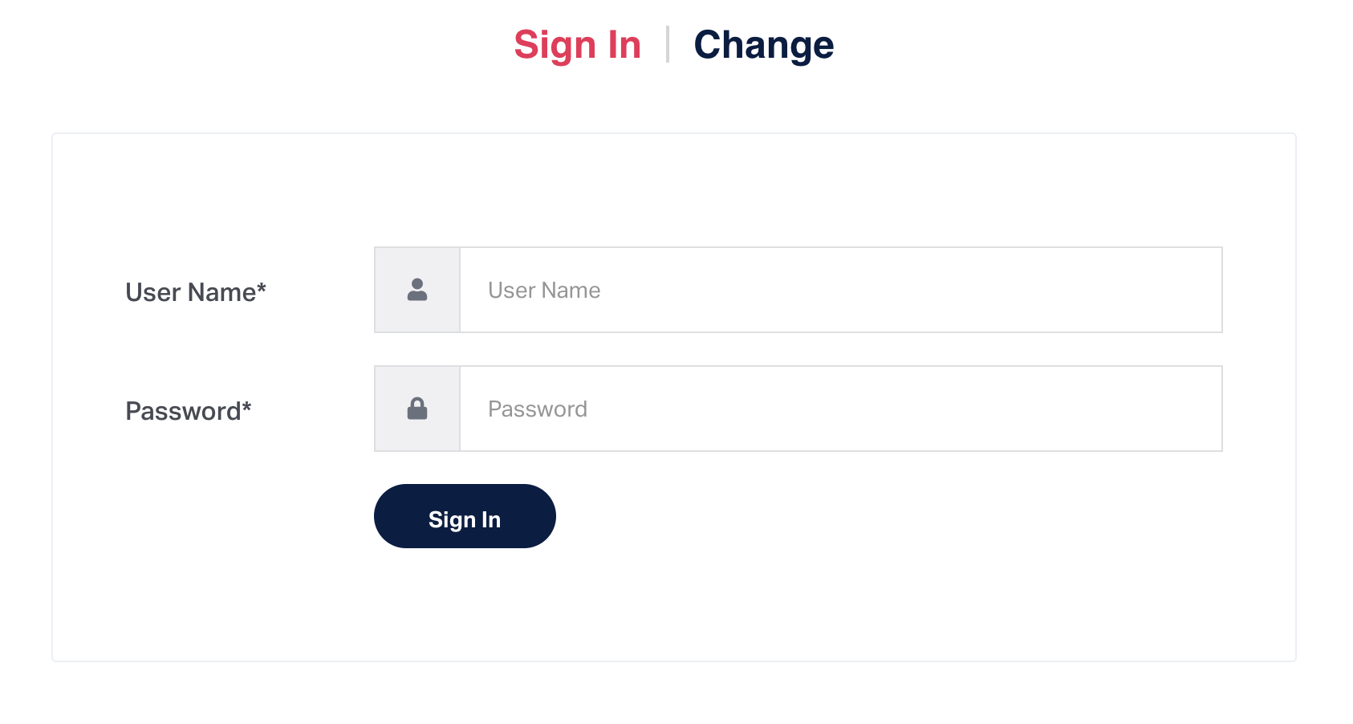
Log-in Page

Slide 5
Log-in Page
Log in private account
Type in your Amazon ID as username and initial password which is "123456".
Interceptor & Cookie
You will get into the system only if the password is correct. The system will remember the login status for 1 hour.
Change password
Click the "change" button, you will be able to change your own password.

Slide 6
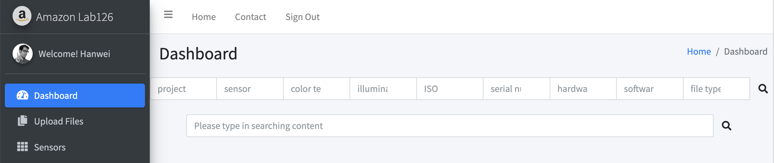
Dashboard Page

Slide 7
Dashboard Page
Sign out
Click on "sign out" button and log-in status will be reset.
Search
Search files by project, sensor, color temperature, illuminance, ISO, serial number, hardware version, software version, file type.
Search files directly by its name (match the context you type in).
Copy name
The file name can be copied by clicking the small file button.

Slide 8
Dashboard Page
Preview
The preview image is shown on the left side, the file size is on the right side.
Download
Clicking the file name link will download this file automatically.
Delete
Clicking the trash bucket button will delete the selected files

Slide 9
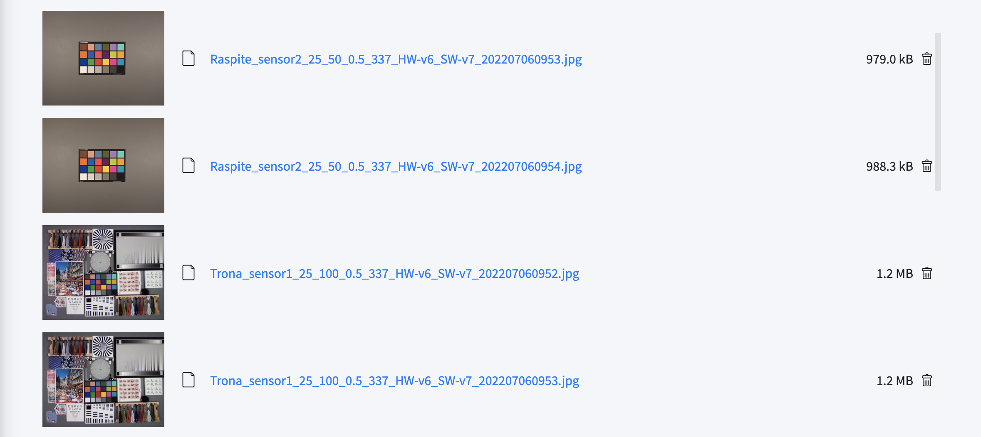
Dashboard Page

Slide 10
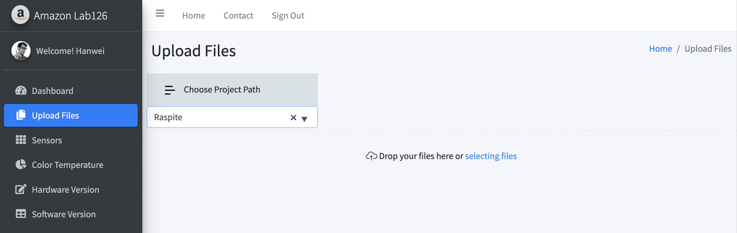
Upload Page

Slide 11
Upload Page
Choose the upload path
Type in path and press enter button to check the access (initial access is "Test" ).
Selecting files
Click the blue "selecting files" to choose the multiple files.
Drag files
Upload multiple files directly by dragging them to the file uploading zone.
Files named as: {project}_{sensor}_{color temperature}_{illuminance}_{ISO}_{serial number}_{hardware version}_{software version}_{extension}.{file type}
for example, Raspite_sensor2_25_200_0.5_337_HW-v6_SW-v7_202207060952.jpg

Slide 12
Demo
http://localhost:63300

Slide 13
Thank you!
Q & A

